Slide 1
Unit 1 Smart home, smart city
Write

Slide 2
Write
Unit 1
Situation スマートシティー展示会の会場
Task 展示会のアンケート用紙に短いコメントを記入する
After watching the exhibition, you were asked to complete a questionnaire. Write a short comment about a booth you visited. Below are details of two booths.

Slide 3
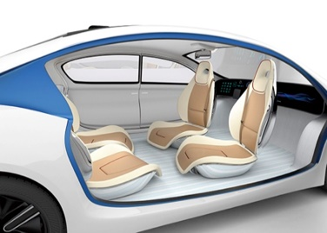
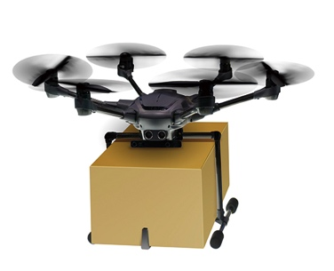
Write
Unit 1
Booth | Explanation | Effect
self-driving car | ・AI drives the car. ・AI gets traffic information and chooses the best routes. | ・avoids traffic accidents ・useful for elderly or disabled people ・reduces traffic jams
delivery drone | ・Drones deliver items by flying. ・Drones can fly in bad weather conditions. ・Drones don’t need a driver. | ・deliver items quickly to remote areas ・deliver items to disaster areas safely ・reduce labor costs

Slide 4
Write
Unit 1
Visitor Survey
Thanks so much for filling out our survey. We will use your opinions to improve our next exhibition.
Q1. Did you enjoy this exhibition? ○ Yes ○ No
Q2. Which booth(s) did you see?
Q3. What do you think about the booth(s) you saw?

Slide 5
Write
Unit 1
Key words and expressions for thinking
questionnaire アンケート用紙 visitor survey 来訪者調査
helpful 役立つ，助けになる convenient 便利な
solve ～を解決する environment 環境
I think that ... 私は…だと思う
It was impressive[interesting] that ...
…が印象的だった［興味深かった］ I hope that ... …だといいと思う
I want my city [the company] to do
私の町［その企業］に～してもらいたい

Slide 6
Write More
Unit 1
Situation 自分の英語日記ブログ
Task 展示会に行ってきた感想を書く
Next, you will write about the exhibition you watched on your blog. Write more sentences to add information.

Slide 7
Write More
Unit 1
Task 1
Example 1: Blog written by Yan
Yan’s comment: I think delivery drones are very helpful for our city.
I visited the Smart City Exhibition and got interested in the delivery drone booth.
I think delivery drones are very helpful for our city.
Drones can fly and deliver items quickly to people in remote areas.
I hope this service will start soon.

Slide 8
Write More
Unit 1
Example 2: Blog written by Scott
Scott’s comment: It was impressive that self-driving cars are useful for reducing traffic jams.
I visited the Smart City Exhibition and really enjoyed the self-driving car booth. It was impressive that self-driving cars are useful for reducing traffic jams.
When traffic jams are reduced, we can reduce CO₂.

Slide 9
Write More+
Unit 1
Task 1
Blog written by Yan:
I visited the Smart City Exhibition and got interested in the delivery drone booth. (A)Drones can fly and deliver items quickly in remote areas. I think delivery drones are very helpful for our city. (B) I hope this service will start soon.
(A)ドローンの利点を簡潔に説明している。
(B)サービス開始への希望を簡潔に述べている。

Slide 10
Write More+
Unit 1
Blog written by Yan:
I visited the Smart City Exhibition and got interested in the delivery drone booth. (A)
Drones can fly and deliver items quickly to people in remote areas. I think delivery drones are very helpful for our city. (B) I hope this service will start soon.
In our city, people in
remote areas cannot go shopping easily.
When it starts, our lives in this city will be more convenient.
(A)ドローンの利点を現状の問題も含めて詳しく説明している。
(B)サービス開始への希望を，それによる効果とともに述べている。

