Slide 1
Unit 1 Smart home, smart city
Speak②

Slide 2
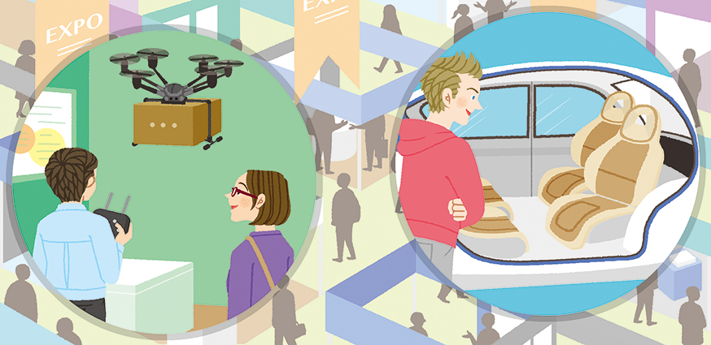
Speak②
Unit 1
Situation スマートシティー展示会の会場
Task 展示ブースの内容を共有し，自分たちの町にあるとよいものを見つける
You (A and B) came to the exhibition hall in the Smart City Exhibition. You each visited a different booth. Then you met again outside the hall.

Slide 3
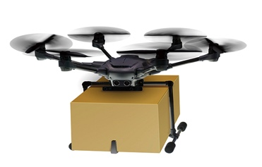
Speak②
Unit 1
Role A
Share the information about the booth with B , and talk about which is useful for your city.
A’s Mission
The booth you saw is as follows :
The booth | Explanation | Effect
delivery drone | ・Drones deliver items by flying. ・Drones can fly in bad weather conditions. ・Drones don’t need a driver. | ・deliver items quickly to remote areas ・deliver items to disaster areas safely ・reduce labor costs

Slide 4
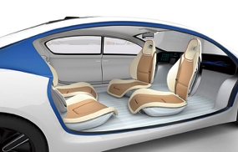
Speak②
Unit 1
Role B
Share the information about the booth with A , and talk about which is useful for your city.
B’s Mission
The booth you saw is as follows :
The booth | Explanation | Effect
self-driving car | ・AI drives the car. ・AI gets traffic information and chooses the routes. | ・avoid traffic accidents ・useful for elderly or disabled people ・reduce traffic jams

Slide 5
Speak②
Unit 1
▼ Start from the following line:
B: “Which booth did you see?”
Key words and expressions for thinking
booth （イベントなどの）ブース self-driving 自動運転の accident 事故 reduce ～を減らす traffic jam 交通渋滞 route 経路 elderly people 高齢者
disabled people 障がい者 drone ドローン item 品物 remote area 遠隔地 weather condition 気象条件
disaster 災害 eco-friendly 環境に優しい convenient 便利な labor cost 人件費

Slide 6
Speak②
Unit 1
Useful Expressions②
I saw the delivery drone booth.
私は宅配ドローンのブースを見ました。
2. People in remote areas will get items quickly.
遠隔地の人々はすぐに品物を手に入れるでしょう。

Slide 7
Speak②
Unit 1
Useful Expressions②
3. I think (that) the car is useful for our city.
その車は私たちの町に役立つと思います。
4. Self-driving cars will make this city’s air cleaner.
自動運転車はこの町の空気をよりきれいにするでしょう。

Slide 8
Speak②
Unit 1
Speak Again②
Talk to each other again. You can use Useful Expressions.

Slide 9
Speak②
Unit 1
Model Dialogue

Slide 10
Speak②
Unit 1
Model Dialogue
B: Which booth did you see?
A: I saw the delivery drone booth. Drones can fly to deliver items, so people in remote areas will get items quickly. Also, in times of disaster, drones can deliver items safely.
B: I see. I think it’s useful for people who can’t go out very often.
A: I think so. What did you see?
B: I saw the self-driving car booth. AI drives the car, so elderly or disabled people can use it safely. Also, it chooses the best routes by getting traffic information. So it will reduce traffic jams.
A: That’s great. I think it’s useful for our city because there are a lot of traffic jams.
B: That’s right. If there are no traffic jams, we can reduce CO₂. Self-driving cars will make this city’s air cleaner.

Slide 11
Speak②
Unit 1
Model Dialogue
B: Which booth did you see? 質問
A: I saw the delivery drone booth. Drones can fly to deliver items, so people in remote areas will get items quickly. Also, in times of disaster, drones can deliver items safely. 説明→追加説明
B: I see. I think it’s useful for people who can’t go out very often. 理解→意見

Slide 12
Speak②
Unit 1
Model Dialogue
A: I think so. What did you see? 同意→質問
B: I saw the self-driving car booth. AI drives the car, so elderly or disabled people can use it safely. Also, it chooses the best routes by getting traffic information. So it will reduce traffic jams. 説明→追加説明

Slide 13
Speak②
Unit 1
Model Dialogue
A: That’s great. I think it’s useful for our city because there are a lot of traffic jams.
反応→意見
B: That’s right. If there are no traffic jams, we can reduce CO₂. Self-driving cars will make this city’s air cleaner.
同意→補足

Slide 14
Speak②
Unit 1
Speak More
Continue the dialogue in two different ways (① and ②). For each way, choose either (a) or (b).
①相手の気持ちを尋ねる感じで
質問する
〇
A: (a) Are you interested in going to another exhibition next month?
(b) What else did you learn at the exhibition today?
B: Yes, of course. 応答する

Slide 15
Speak②
Unit 1
②相手の意向をうかがう感じで
提案する
A: (a) Please write a report about today’s exhibition.
(b) Shall we share the information with our classmates?
B: That’s a good idea.
賛成する
〇

