Slide 1
Unit 1 Smart home, smart city
Speak①

Slide 2
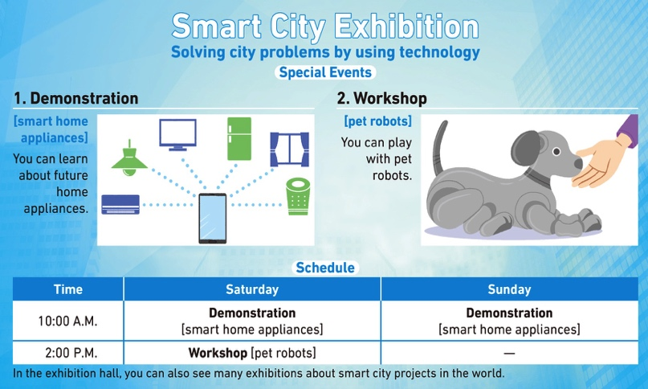
Speak①
Unit 1
Situation スマートシティー展示会のお知らせを読みながらの会話
Task クラスメイトとスケジュールを相談し，参加するプログラムを決める
You (A and B) are classmates. You are reading a flyer of the Smart City Exhibition. You want to go together and join one of the events in the exhibition.

Slide 3
Speak①
Unit 1
Role A
Talk to B about the schedule and decide which event you will join.
A’s Mission
Your schedule is as follows :
Time | Saturday | Sunday
A.M. | ○ | △ play badminton
P.M. | ○
○＝free △＝you can change the schedule
×＝not free

Slide 4
Speak①
Unit 1
Talk to A about the schedule and decide which event you will join.
Role B
B’s Mission
Your schedule is as follows :
Time | Saturday | Sunday
A.M. | × piano lesson (every Saturday) | ○
P.M. | △ go shopping | ○
○＝free △＝you can change the schedule
×＝not free

Slide 5
Speak①
Unit 1
▼ Start from the following line:
B: “Are you free on Saturday or Sunday?”
Key words and expressions for thinking
demonstration 実演
workshop 研修会，ワークショップ
smart home appliance スマート家電
schedule 予定，スケジュール
reschedule スケジュールを変更する

Slide 6
Speak①
Unit 1
Useful Expressions①
1. I’m going to play badminton on Sunday.
日曜にバドミントンをするつもりです。
2 I have a piano lesson every Saturday morning.
毎週土曜の午前中にピアノのレッスンを受けています。

Slide 7
Speak①
Unit 1
Useful Expressions①
3. I was planning to go shopping in the afternoon.
その日の午後にショッピングに行く予定でした。
4. The workshop starts at 2 p.m.
そのワークショップは午後2時に始まります。
5. I will reschedule.
私がスケジュールを変更しましょう。

Slide 8
Speak①
Unit 1
Speak Again①
Talk to each other again. You can use Useful Expressions.

Slide 9
Speak①
Unit 1
Model Dialogue

Slide 10
Speak①
Unit 1
Model Dialogue
B: Are you free on Saturday or Sunday?
A: I’m free on Saturday. I’m going to play badminton on Sunday, but I can change my schedule. How about you?
B: I’m free all day on Sunday, but I have a piano lesson every Saturday morning. I was planning to go shopping in the afternoon, but I can go another time.
A: OK. Then, which event do you want to join?
B: Well, I want to see pet robots, so how about going to the workshop on Saturday? It starts at 2 p.m. I will reschedule.
A: Really? I’m also interested in pet robots. Thank you for changing your schedule.

Slide 11
Speak①
Unit 1
Model Dialogue
B: Are you free on Saturday or Sunday? 質問
A: I’m free on Saturday. I’m going to play badminton on Sunday, but I can change my schedule. How about you? 応答→説明→質問
B: I’m free all day on Sunday, but I have a piano lesson every Saturday morning. I was planning to go shopping in the afternoon, but I can go another time. 応答→説明

Slide 12
Speak①
Unit 1
Model Dialogue
A: OK. Then, which event do you want to join?
理解→次の質問
B: Well, I want to see pet robots, so how about going to the workshop on Saturday? It starts at 2 p.m. I will reschedule. 応答→提案
A: Really? I’m also interested in pet robots. Thank you for changing your schedule.
反応→共感→感謝

Slide 13
Speak①
Unit 1
Speak More
Continue the dialogue in two different ways (① and ②). For each way, choose either (a) or (b).
①安心させる感じで
応答する
B: (a) It’s no problem at all.
(b) I’m sorry you have to reschedule.
A: I’m relieved to hear that.
安心する

Slide 14
Speak①
Unit 1
②次の話題に移る感じで
提案する
〇
B: (a) How about deciding the meeting place?
(b) How long does it take to get to the exhibition?
A: Sure. 賛成する

