Slide 1
Unit 1 Smart home, smart city
Small Talk, Listen

Slide 2
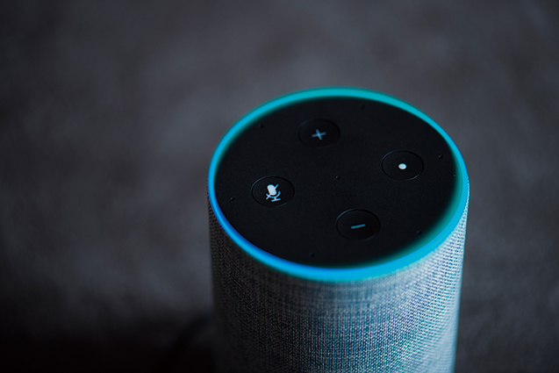
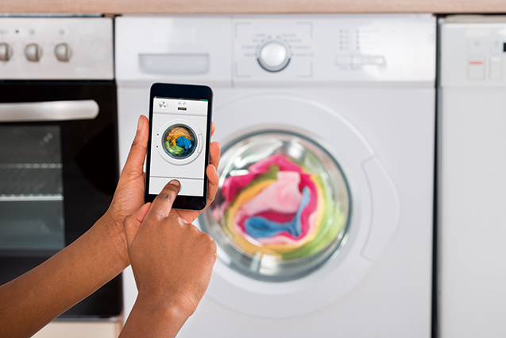
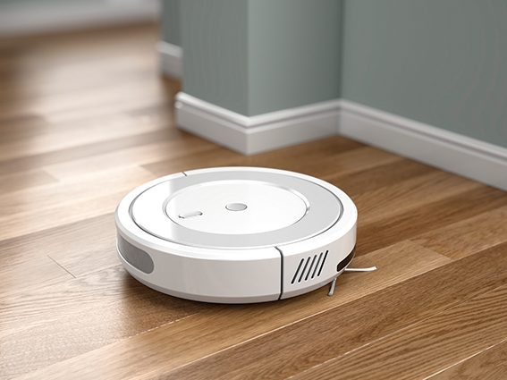
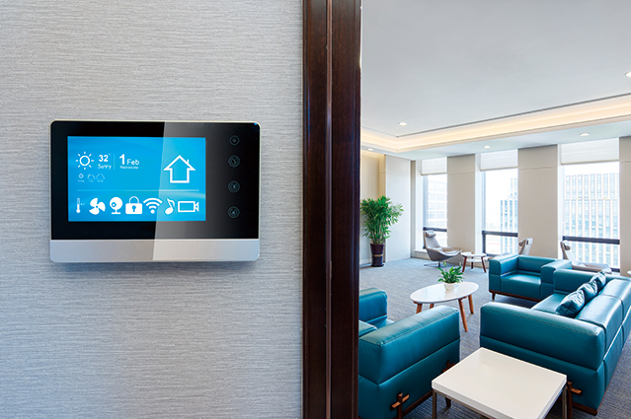
Small Talk
Unit 1
Do you have any smart home appliances at your house?
What kind of smart home appliance do you want in the future?
Model Talk
Standard script
Advanced script

Slide 3
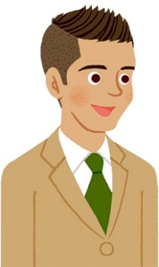
Listen
Unit 1
Pedro and Dao are talking about a smart home appliance. Listen to the conversation and fill in the blanks.
①Smart home appliance: [ ] vacuum cleaner
robot
has
③She [ ] one at home.
Pedro
Dao
②He [ ] one.
wants
④It can’t [ ] when there are things on the floor.
⑤Dao likes its [ ] movements.
move
cute

Slide 4
Listen Again
Unit 1
Listen again, and fill in each blank below.
After that, choose one similar expression from (a) ～ (c).
Communication Strategy ①
相手の発言に驚いて反応するには？
Dao: I have one in my house, but it’s not perfect.
Pedro: ① Is that so ? Why is that?
(a) True (b) Is that so (c) Are you all right
Really
〇

Slide 5
Listen Again
Unit 1
Communication Strategy ②
相手に同情する気持ちを伝えるには？
Dao: I have to pick them up before I use it.
Pedro: ② That’s a pity . So you don’t use it so often, right?
(a) That’s amazing (b) I can’t believe it
(c) That’s a pity
That’s too bad
〇

Slide 6
Listen Script
Unit 1
Pedro(P): Ah, it’s already time to clean up, but I don’t want to do it.
Dao(D): What are you saying, Pedro! Let’s do it together.
P: I want a robot vacuum cleaner. I heard it cleans the floor just by talking to it.
D: I have one in my house, but it’s not perfect.
P: Really? Why is that?
D: It can’t move when there are things on the floor. I have to pick them up before I use it.
P: That’s too bad. So you don’t use it so often, right?
D: Well, I use it every day because I like its cute movements.
P: Ha-ha. That’s interesting. I will ask my parents to buy one.
D: Anyway, we have to clean this room up now.

Slide 7
Listen Script
Unit 1
Pedro(P): Ah, it’s already time to clean up, but I don’t want to do it.
Dao(D): What are you saying, Pedro! Let’s do it together.
P: I want a robot vacuum cleaner. I heard it cleans the floor just by talking to it.
D: I have one in my house, but it’s not perfect.
P: Really? Why is that?

Slide 8
Listen Script
Unit 1
D: It can’t move when there are things on the floor. I have to pick them up before I use it.
P: That’s too bad. So you don’t use it so often, right?
D: Well, I use it every day because I like its cute movements.
P: Ha-ha. That’s interesting. I will ask my parents to buy one.
D: Anyway, we have to clean this room up now.

Slide 9
Model Talk (Standard version)
Unit 1
A: Do you have any smart home appliances at your house?
B: Well, we recently bought a new scale.
A: What kind of scale is it?
B: It’s a scale to check your weight. It can also tell the percentage of fat and muscle in your body.
A: Wow, it helps you check your condition.
B: Yes. How about you? Do you have any smart home appliances?
A: No, but I want one in the future.
B: What kind do you want?
A: I want a smart speaker. It can play music, show emails you get, and even wake you up in the morning!
B: That’s useful.

Slide 10
Model Talk (Advanced version)
Unit 1
A: Do you have any smart home appliances at your house? Recently, they have been becoming popular.
B: Smart home appliances…, well, we recently bought a new scale.
A: What kind of scale? For cooking?
B: No, it’s a scale to check your weight. It can even tell the percentage of fat and muscle in your body. Also, you can keep a record and read the graph on your smartphone.
A: That sounds great. It will be a great help for your health.
B: Exactly. How about you? Do you have any smart appliances at home?
A: No, but I want one in the future.
B: What kind do you want?
A: I want a smart speaker. It can play music, show emails you get, and even wake you up in the morning! Isn’t it convenient?
B: Excellent! You should get one soon. I’m sure it will make your life more enjoyable.

