Slide 1
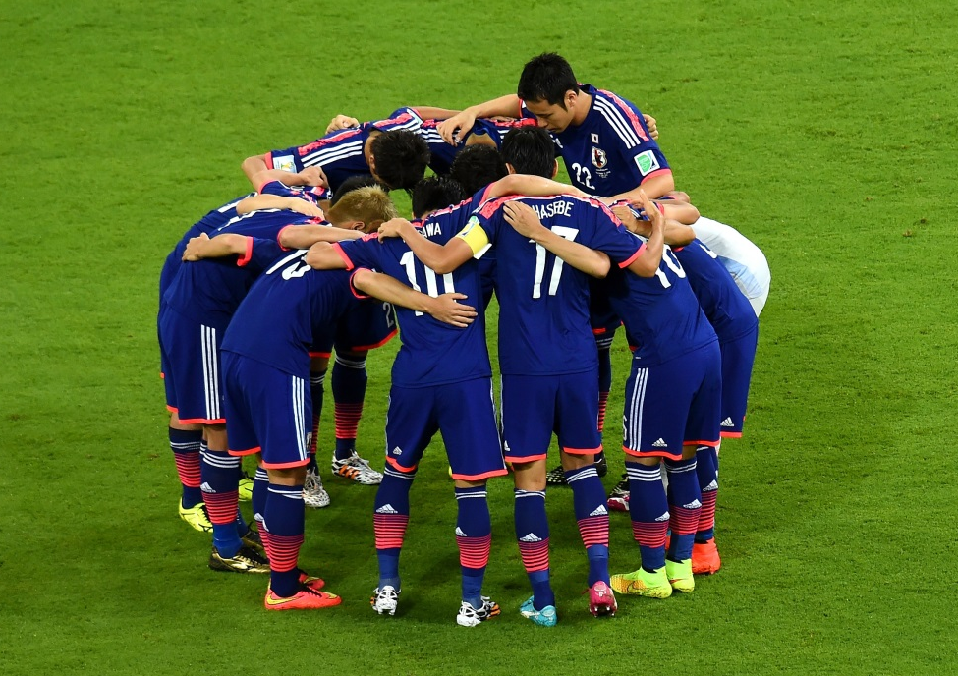
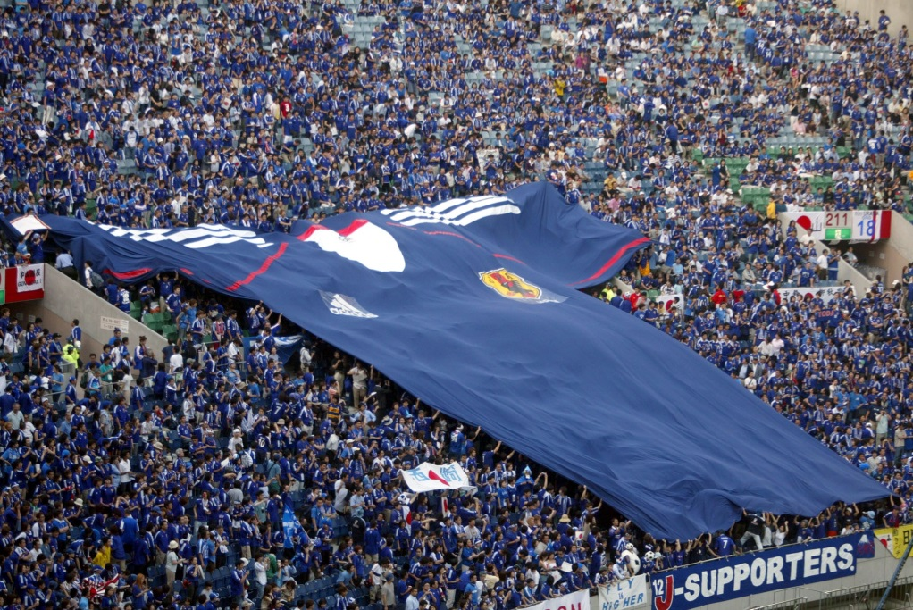
Introduction
soccer
supporters
Japan national team
uniforms
uniforms
support
same team
cheer ~ on

Slide 2

The FIFA World Cup is the championship of the national soccer teams from all over the world. It is the largest sporting event in the world. More people watch it than the Olympics.
During the championship, the world’s top players play their best for their country. But we the supporters have a role in the game, too. Many of us wear our favorite team’s uniform to cheer them on. These uniforms can help unite us with the players.
Uniforms, however, do more than just unite people. They can tell us many things about a country.

Slide 3
The FIFA World Cup is the championship of the national soccer teams from all over the world. It is the largest sporting event in the world. More people watch it than the Olympics.

Slide 4
During the championship, the world’s top players play their best for their country. We the supporters also have a role in the game. Many of us wear our favorite team’s uniform to cheer them on. These uniforms can help unite us with the players.

Slide 5
Uniforms, however, do more than just unite people. They can tell us many things about a country.

Slide 6
Q & A
Which sporting event do more people watch, the FIFA World Cup or the Olympics?
The FIFA World Cup.
2. What role do supporters have in the game?
Supporters wear their favorite team's uniform to cheer them on.
3. What can these uniforms help?
They can help unite us with the players.

Slide 7
Q & A
4. What things do you think uniforms can tell us? Give me some examples.
They can tell us something about a country, for example, its history, environment, culture, and so on.

Slide 8
Get the Gist
Many supporters cheer their team on by wearing their team’s ( ). T / F
Uniforms can help ( ) us with the players. T / F
Uniforms can tell us many things about a ( ). T / F
uniform
unite
team

Slide 9
Story Retelling
soccer
supporters
Japan national team
uniforms
uniforms
cheer ~ on
same team
country

Slide 10
Story Retelling
These are soccer players on the Japan national team. They wear uniforms. The uniform shows they are on the same team.
These are supporters of the Japan national team. They wear uniforms to cheer the team on.
Uniforms can tell us many things about a country.

Slide 11
Grammar
助動詞 can （可能）
「～することができる」＝can ＋ 動詞の原形
・These uniforms can help unite us with the players. （肯定文）
・Can you speak French？ （疑問文）
・I can’t play soccer very well. （否定文）

Slide 12
Practice
7時までに帰らなければならない。
We get home by 7:00.
お名前を教えてもらえますか。
I have your name?
私はまったく泳げない。
I swim at all.
must
May
can’t

